Slide 1
Truncating
Estimation and rounding

Slide 2
how to use Oak lessons

Slide 3
I can estimate a value by truncating to a given degree of accuracy.

Slide 4
A degree of accuracy shows how precise a number or measurement is.
E.g. to the nearest cm, nearest 10, 1 s.f., etc.

Slide 5
Truncation is the simplifying of a number by 'cutting off' one or more of the digits and replacing them with zeros if necessary to preserve place value.
For example
3678 truncated to 1 s.f. is 3000
For example
0.3678 truncated to 2 d.p. is 0.36

Slide 6

Truncating
Truncating
Truncating in real life

Slide 7

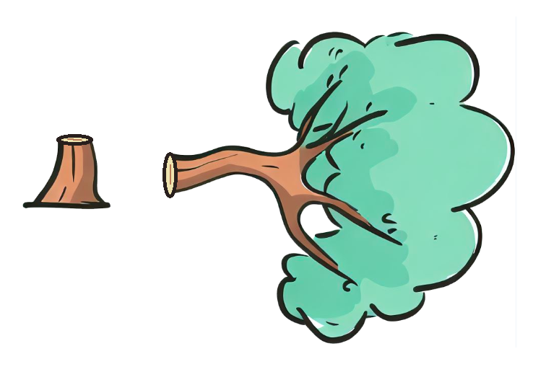
Truncating
Truncate comes from the Latin word “truncare”, which means “to shorten” and originates from the word truncus which means “trunk”.
Essentially, we are shortening a number to just give the trunk of a number.

Slide 8





Truncating
For example, truncate 4589 to 1 significant figure.
.
4
.
0 0 0
4 5 8 9
What is the first significant figure?
The first significant figure is 4
This is the trunk or digit we keep.
Ensuring we keep the magnitude of the number, we insert the zeros where needed.

Slide 9
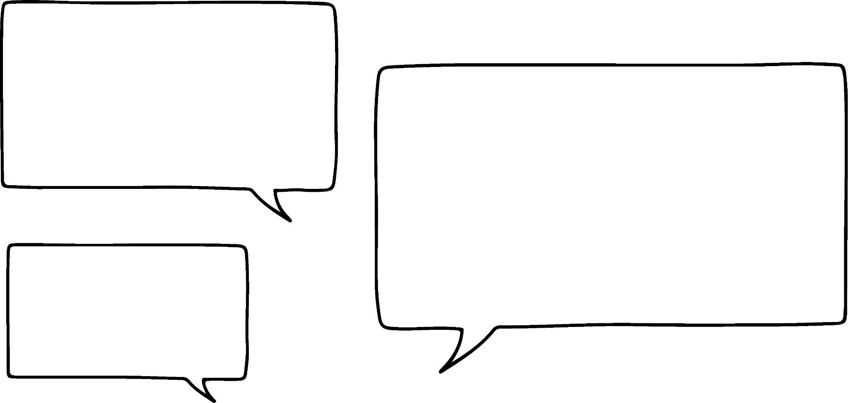

Truncating
Aisha says:
When I truncate 4589 to 1 significant figure, I get 5000.
Aisha
Can you explain why Aisha thinks the answer is 5000?
Aisha has rounded to 1 significant figure.
This is different to truncating to 1 significant figure.
When truncating you do not change any of digits before the truncation.

Slide 10
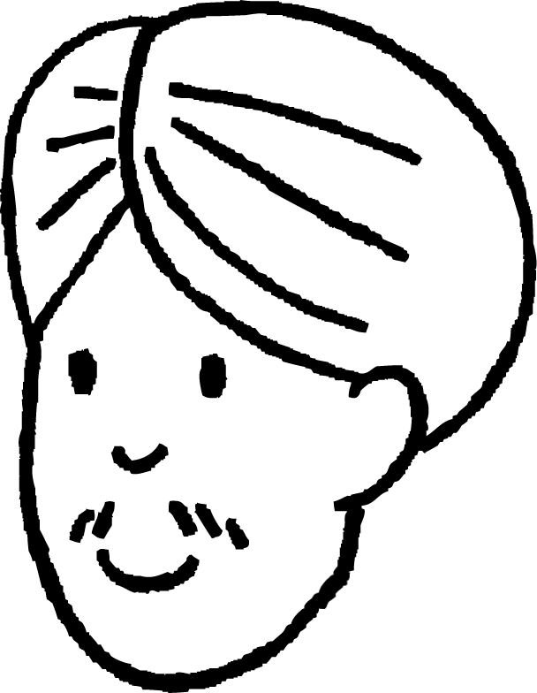
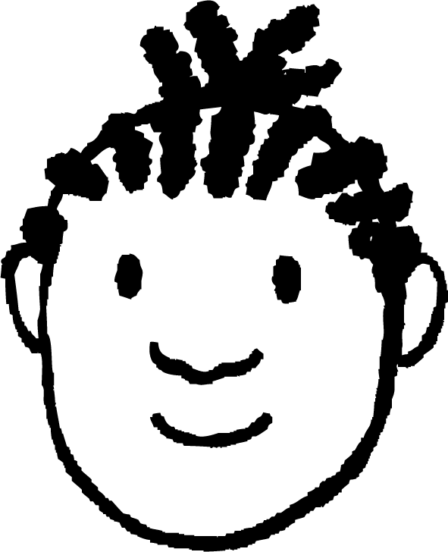
Truncating
Truncate 59 894 to 2 significant figures.
Who is correct? Can you explain the other errors?
It’s 60 000
The answer is 59
Andeep
Jacob
The answer is 59 000
Aisha. Jacob just wrote the first 2 s.f. and lost the magnitude of the number. Andeep has rounded the number to 2 s.f.
Aisha

Slide 11
Truncating
Pair up the numbers with the truncated values.
1 0 0 0
1 5 9 8
truncated to 1 s.f. is 10
2 6 5 4
truncated to 1 s.f. is 1000
2 0 0 0
2 0 . 5 6 3
2 4 . 5 6 3
truncated to 1 s.f. is 2000
1 0 . 9 8 6
1 9 . 9 8 6
truncated to 1 s.f. is 20

Slide 12
Truncating
We can truncate large and small numbers.
The process is still the same. It is important to pay attention to the degree of accuracy.
For example, truncate 0.027815 to 2 significant figures.
0 . 0 2 7
0 . 0 2 7 8 1 5
What digit is the second significant figure?
The second significant figure is 7
This is the trunk or digit we keep.
Ensuring we keep the magnitude of the number, we insert the zeros where needed.

Slide 13


Truncating
Three pupils were given this instruction.
“Truncate 12.235 to 2 decimal places.”
Who is correct? Explain the error the other students have made.
It is
12.23
It is
12
It is
12.24
Jacob
Andeep
Jun
Andeep has rounded to 2 s.f. or the nearest integer.
Jacob has truncated the number to 2 d.p.
Jun has rounded to 2 d.p.

Slide 14
Truncating
Fill in the table below.
Number | Truncate to 2 significant figures | Truncate to 2 decimal places
5682.6234
0.86252
682.9956
0.000125
5682.6234
5600
5682.62
5682.6234
0.86252
0.86
0.86
682.9956
682.9956
680
682.99
0.000125
0.000125
0.00012
0.00

Slide 15
Truncating
Complete the table.
Number | Truncate to 1 significant figure | Truncate to 2 significant figures | Truncate to 1 decimal place
89 231.625
0.05681
0.0002563
23.145
19.99999

Slide 16
Truncating
2) Fill in the cross number puzzle.
1
6
Across
2) Truncate 63215 to 3 s.f.
3) Truncate 0.321986 to 3 d.p.
Down
1) Truncate 56842 to thousands
4) Truncate 2331.124 to 3 s.f.
5) Round 13.856 to 2 s.f.
6) Round 10.13986 to 2 d.p.
2
4
3
5

Slide 17
Truncating
3) Work out the number given the clues.
I am ………….
Truncated to 1 s.f. I am 200
I am a multiple of 12
I am 250 when rounded to the nearest 25
I am a palindrome (number reads the same if all the digits reversed)
b) I am ………..
Truncated to 1 s.f. I am 100
I am a multiple of 4
I am 200 when rounded to the nearest 100
The sum of my digits is 15

Slide 18
Truncating
Complete the table.
Number | Truncate to 1 significant figures | Truncate to 2 significant figures | Truncate to 1 decimal place
89 231.625 | 80 000 | 89 000 | 89 231.6
0.05681 | 0.05 | 0.056 | 0.0
0.0002563 | 0.0002 | 0.00025 | 0.0
23.145 | 20 | 23 | 23.1
19.99999 | 10 | 19 | 19.9
Number | Truncate to 1 significant figure | Truncate to 2 significant figures | Truncate to 1 decimal place
89 231.625
0.05681
0.0002563
23.145
19.99999

Slide 19
Truncating
2) Fill in the cross number puzzle.
1
1
Across
2) Truncate 63215 to 3 s.f.
3) Truncate 0.321986 to 3 d.p.
Down
1) Truncate 56842 to thousands
4) Truncate 2331.124 to 3 s.f.
5) Round 13.856 to 2 s.f.
6) Round 10.13986 to 2 d.p.
5 |  |  |  | 1
6 | 3 | 2 | 0 | 0
0 |  | 3 |  | .
0 | . | 3 | 2 | 1
0 |  | 0 |  | 4
 |  |  |  | .
6
4
2
4
2
5
3
5
3

Slide 20
Truncating
3) Work out the number given the clues.
I am
Truncated to 1 s.f. I am 200
I am a multiple of 12
I am 250 when rounded to the nearest 25
I am a palindrome (number reads the same if all the digits reversed)
b) I am
Truncated to 1 s.f. I am 100
I am a multiple of 4
I am 200 when rounded to the nearest 100
The sum of my digits is 15
252
168

Slide 21
Truncating
Truncating
Truncating in real life

Slide 22

Truncating in real life
Truncating can be used in lots of different ways.
For example, how could you use truncating to estimate the answer to:
813 × 11.8
For example,
813 truncated to 1 s.f. gives 800
11.8 truncated to 1 s.f. gives 10
800 × 10 = 8000
It works well for this calculation, but what about
898 × 18.7?
Laura

Slide 23
Truncating in real life
How could you use truncating to estimate the answer to:
898 × 18.7
For example,
898 truncated to 1 s.f. gives 800
18.9 truncated to 1 s.f. gives 10
800 × 10 = 8000
That means the estimate for
898 × 18.7 is the same as the estimate for 813 × 11.8
Laura

Slide 24
Truncating in real life
Laura is correct. Truncation is a method of approximating numbers and it might be quicker than rounding, but does not always give the best approximation to the original number or an estimate to a calculation.
That means the estimate for
898 × 18.7 is the same as the estimate for 813 × 11.8
Laura

Slide 25

Truncating in real life
I don’t like truncating. It seems unreliable and pointless. Rounding is much better.
Truncating is very useful in everyday life. You probably don’t realise that we truncate often.
Laura
Alex

Slide 26
Truncating in real life
Can you give me another example please?
Can you give me some more examples please?
Of course! Remember you went to the cinema to see the film rated 12? It doesn’t matter if you are 11.99 years old, you are not allowed to see the film as you are classed as 11 years old.
Laura
12
Alex

Slide 27
Truncating in real life
£129 ÷ £5
This is 25.8, so 25 candles.
Sure.
If you had £129 and wanted to buy as many £5 candles as possible, how would you calculate it?
Laura
Alex

Slide 28
Truncating in real life
£129 ÷ £5
This is 25.8, so 25 candles.
Exactly!
You have truncated your answer as you want the integer value only.
Laura
Alex

Slide 29
Truncating in real life
In computer science, ‘INT’ or ‘int’ is used to truncate a number so to only give the integers.
For example,
INT(56/10) will have an output of 5. This is because 56 ÷ 10 = 5.6
We only want the integer so we truncate to give 5.
Work out the output of the following.
INT(123/10)
INT(5.23/2)
INT(48/31)
Output is 12
Output is 2
Output is 1

Slide 30
Truncating in real life
The context of the question determines whether it is suitable to truncate an answer, round an answer or use the exact value of an answer.
Reading the question carefully and thinking about what the value of the answer means will help identify if you need to work out a truncated answer, rounded answer or work out the exact value of an answer.

Slide 31
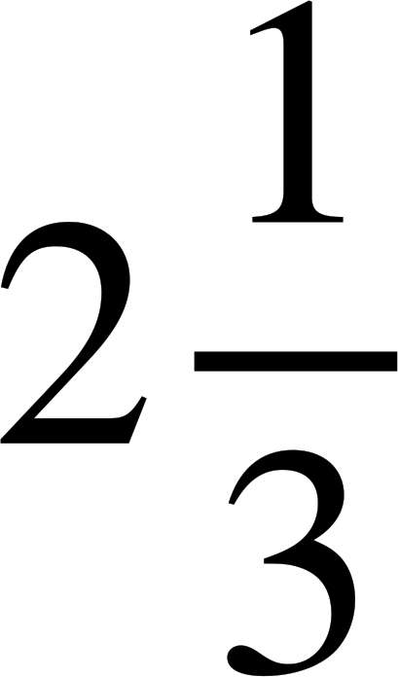
Truncating in real life
Here we have three scenarios which require the calculation
7 ÷ 3
When should you calculate the exact answer, truncate the answer or round the answer?
7 pizzas shared between 3 people
Aisha has £7 and wants to buy as many £3 chocolate bars as possible
A bill of £7 is shared between 3 people.
The exact value so everyone gets a fair share. Each person gets pizzas.
Round because money is 2 d.p. This means each person should pay £2.33
(1 person can pay 1 p more)
Truncate because she can only afford an integer number of chocolates.

Slide 32
Truncating in real life
Given the scenarios below, identify if the answer should be given exactly, rounded or truncated.
Aisha is 14.7 years old and wants to see a 15 Rated film. Can she go?
A book shop has £89 and wants to buy as many £1.99 puzzle books as possible. How many books can it buy?
A bill of £89 is shared between 10 people.

Slide 33
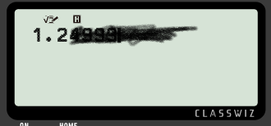

Truncating in real life
2) Here is a broken calculator screen.
What is the largest and smallest number that could be displayed on the screen?

Slide 34
Truncating in real life
3) In computer science, ‘INT’ or ‘int’ is used to truncate a number so to only give the integers.
For example,
INT(56/10) will have an output of 5. This is because 56 ÷ 10 = 5.6. We only want the integer so we truncate to give 5.
Work out the output of the following.
INT(45/8)
INT(98/10) + INT(7.8/3)
INT(8/0.5) + INT(12.65/2) - INT(9.8/6)

Slide 35
Truncating in real life
4) Lucas is going on holiday and looks at the exchange rates.
£1 = 1.16887 Euros
Travel firms and banks offer a truncated value to this:
£1 = 1.16 Euros
a) Why is truncating exchange rates better for travel firms and banks?
b) If £1 000 000 was exchanged, how much money would the travel companies make due to truncation?

Slide 36
Truncating in real life
Given the scenarios below, identify if the answer should be given exactly, rounded or truncated.
Aisha is 14.7 years old and wants to see a 15 Rated film. Can she go?
A book shop has £89 and wants to buy as many £1.99 puzzle books as possible. How many books can it buy?
A bill of £89 is shared between 10 people.
Round because money is 2 d.p. This means each person should pay £8.90
(Or pay £9 each and leave a tiny tip!)
No, the truncated age is 14 years old so she is below age.
Truncate because it can only afford integer number of books.

Slide 37
Truncating in real life
2) Here is a broken calculator screen.
What is the largest and smallest number that could be displayed on the screen?
Given the number is concealed, we see the truncated value.
The largest value is 1.2999999999... and the smallest is 1.2

Slide 38
Truncating in real life
3) In computer science, ‘INT’ or ‘int’ is used to truncate a number so to only give the integers.
For example,
INT(56/10) will have an output of 5
Work out the output of the following.
INT(45/8)
INT(98/10) + INT(7.8/3)
INT(8/0.5) + INT(12.65/2) - INT(9.8/6)
Output is 5
Output is 11 because 9 + 2
Output is 21 because 16 + 6 - 1

Slide 39
Truncating in real life
4) Lucas is going on holiday and looks at the exchange rates.
£1 = 1.16887 Euros
Travel firms and banks offer a truncated value to this:
£1 = 1.16 Euros
a) Why is truncating exchange rates better for travel firms and banks?
b) If £1 000 000 was exchanged, how much money would the travel companies make due to truncation?
For every £1 exchanged, the travel company or bank gain 0.00887 euros.
Multiplying 0.00887 by 1 000 000 gives €8870 gain, so for every £1 000 000 exchanged they earn €8870 due to truncation.

Slide 40
Truncating
We can truncate large and small numbers.
The process is still the same. It is important to pay attention to the degree of accuracy.
Truncation is a method of approximating numbers and it is easier than rounding, but does not always give the best approximation to the original number or an estimate to a calculation.
The context of the question determines whether it is suitable to truncate an answer, round an answer or use the exact value of an answer.

Slide 41

© Oak National Academy 2024.
Produced in partnership with Mathematics in Education and Industry.
Licensed on the Open Government Licence v3.0, except where otherwise stated. See Oak terms and conditions.

